Slide 1
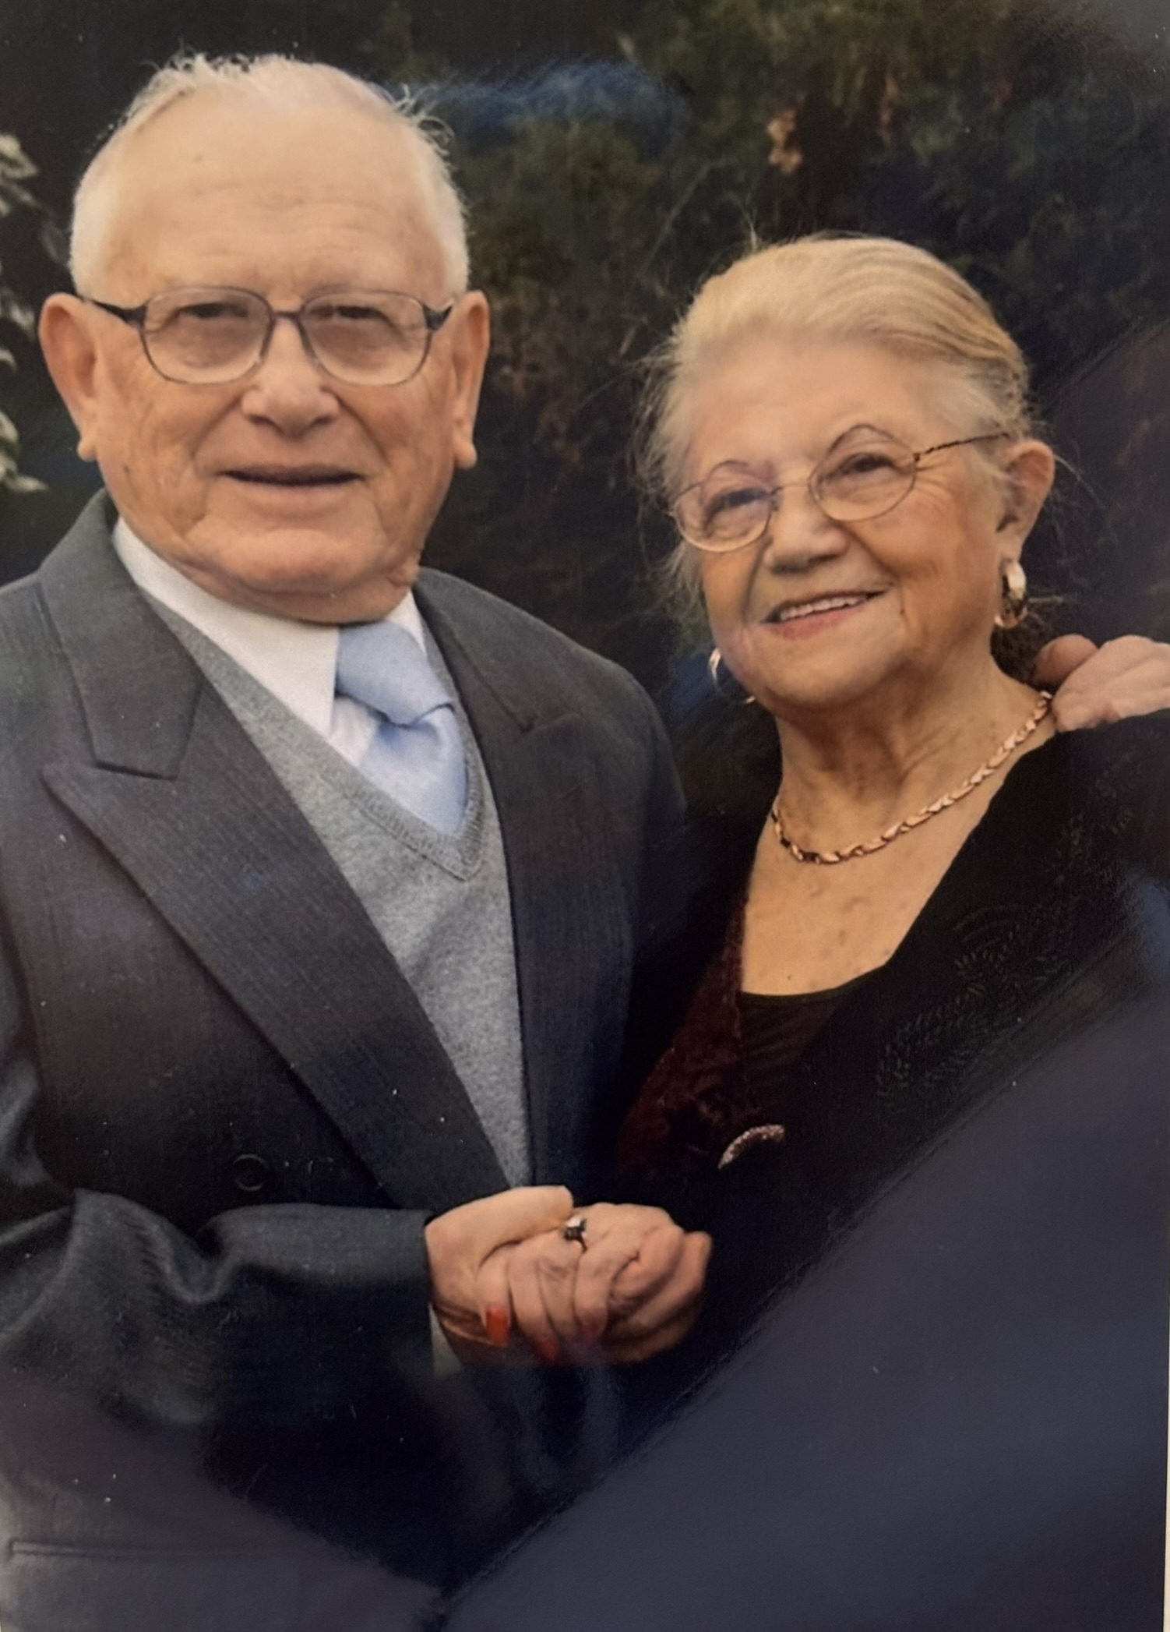
Ruti & Mordechai
Gruber

Slide 2
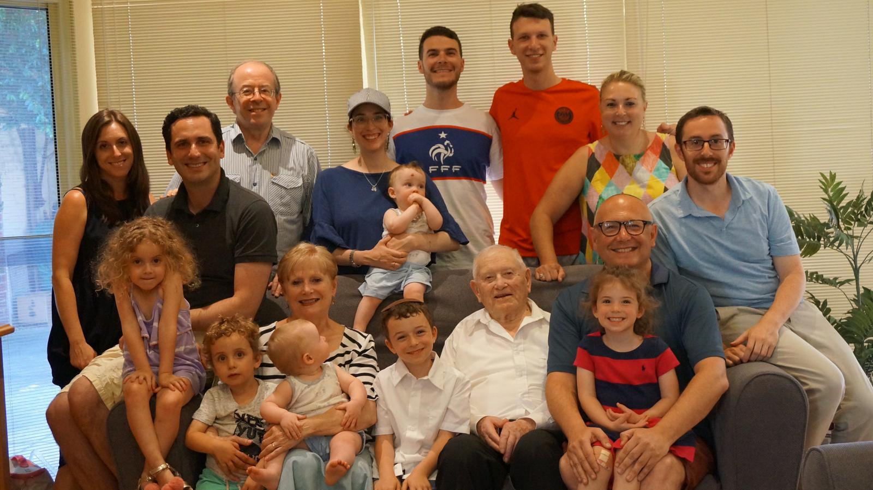
Garfield and Gruber family 2 Children. 6 Grandchildren and 8 great grandchildren

Slide 3
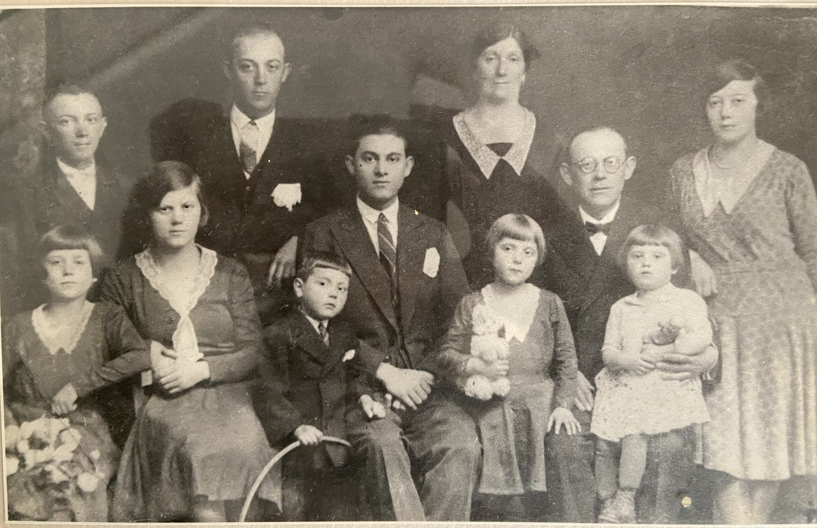
Mendelovits family, Sighet around 1934

Slide 4
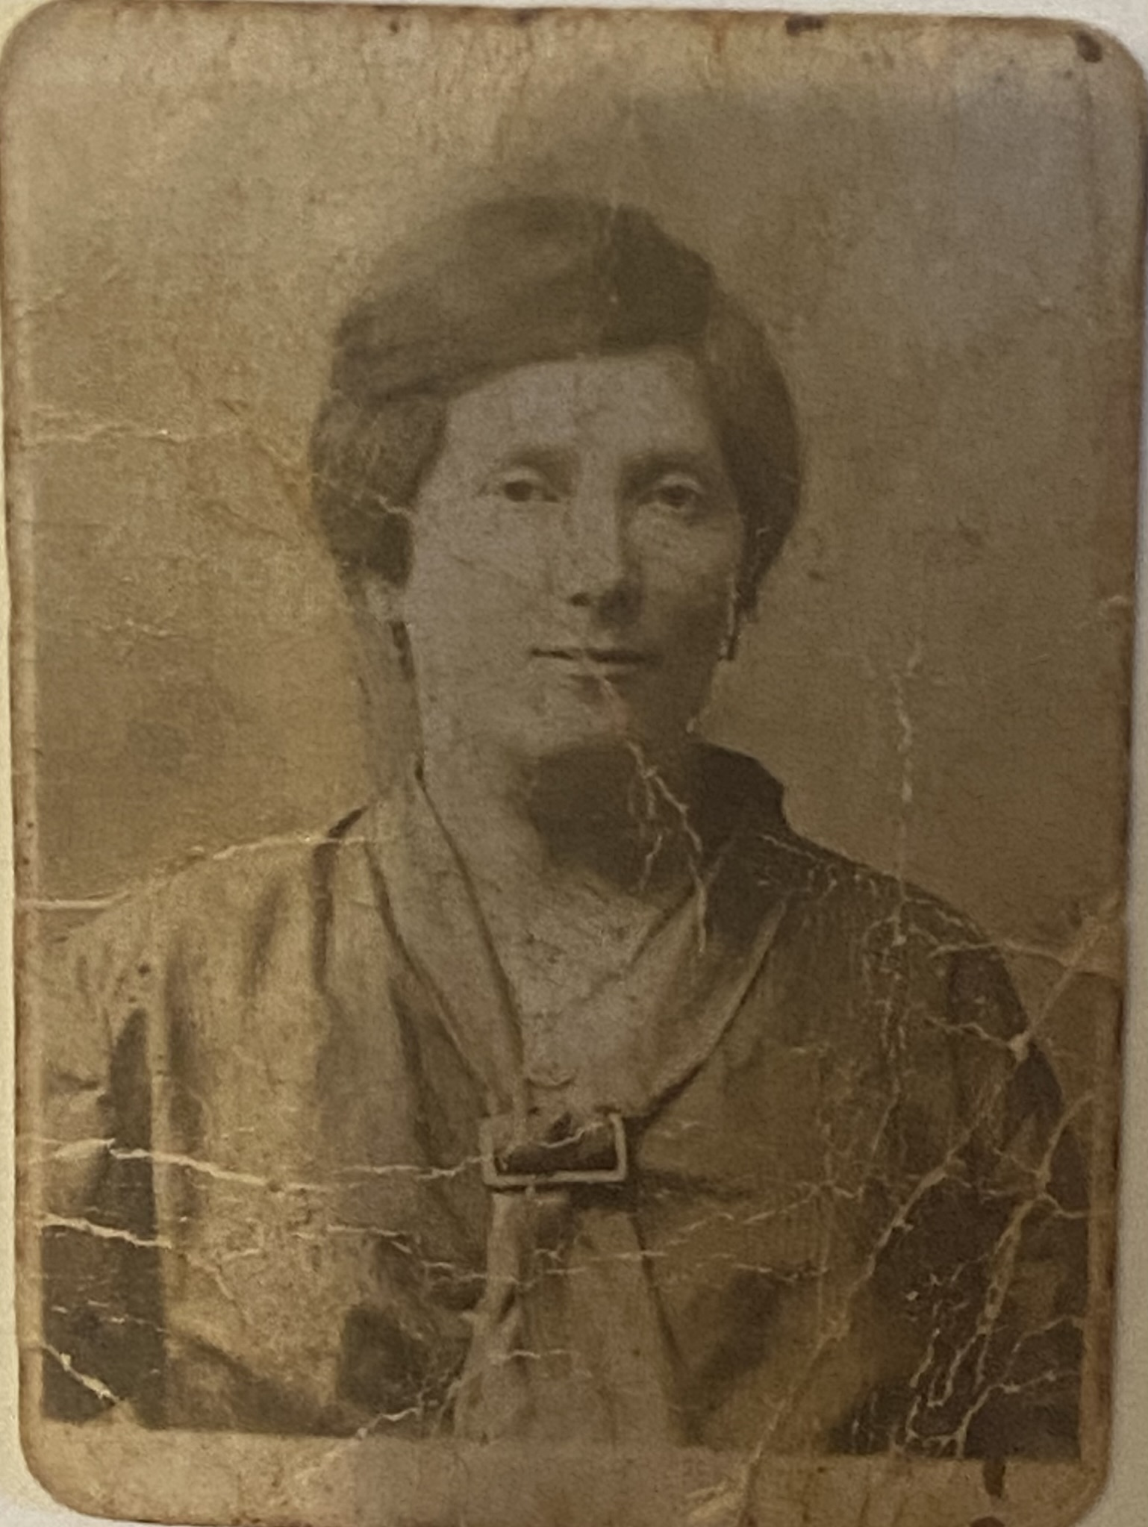
The only photo of Ruti as a young girl Around 1934, she was 3 years old.
Ruti’s mother, Sara Leah

Slide 5
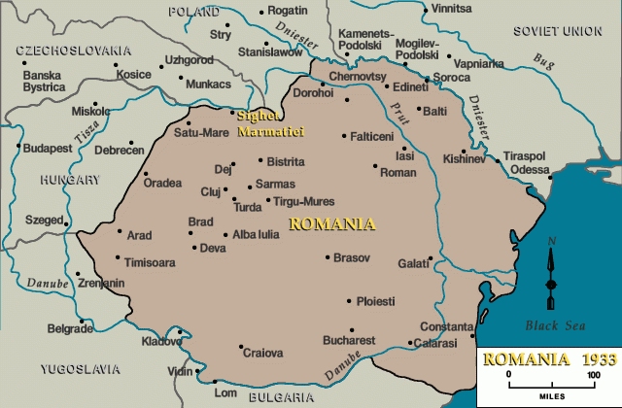
Sighet Maramures, in Northern Transylvania, Romania

Slide 6
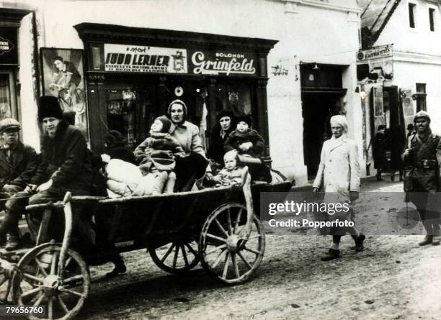
Sighet streets were bustling with horse and carriages before the war. Credit: Getty images

Slide 7
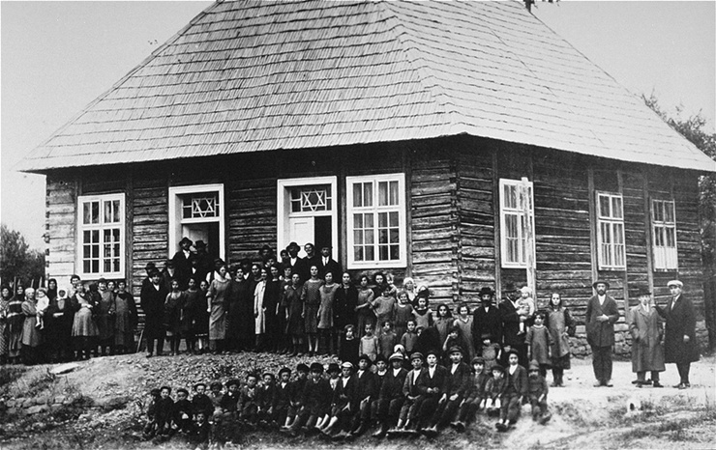
Jewish community on the outskirts of Sighet in front of their synagogue around 1930-1935 Credit: United States Holocaust Memorial Museum

Slide 8
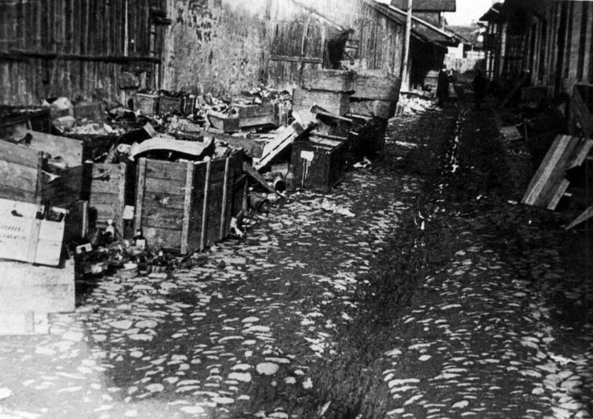
The Sighet Ghetto just after the Jews were deported. May, 1944 Credit: Yad Vashem

Slide 9
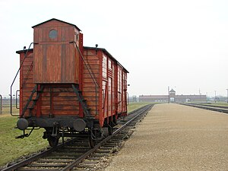
Ruti and her family were transported from Romania by the ‘Death Train’, to Auschwitz, in Poland. A cattle cart that was meant for animals, not people.

Slide 10
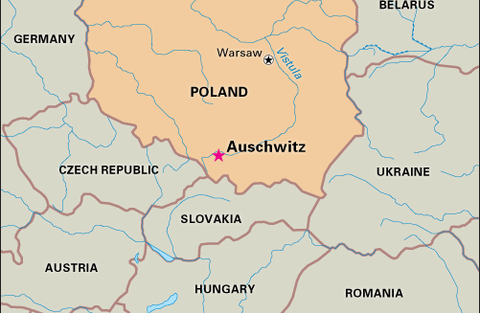
Ruti’s Journey to Auschwitz
Sighet

Slide 11
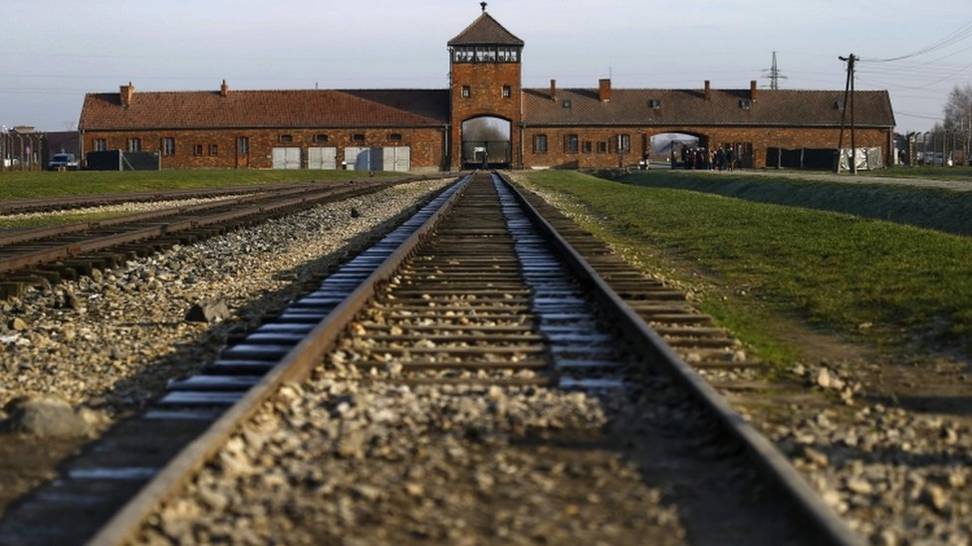
The Train entrance of Auschwitz, Poland

Slide 12
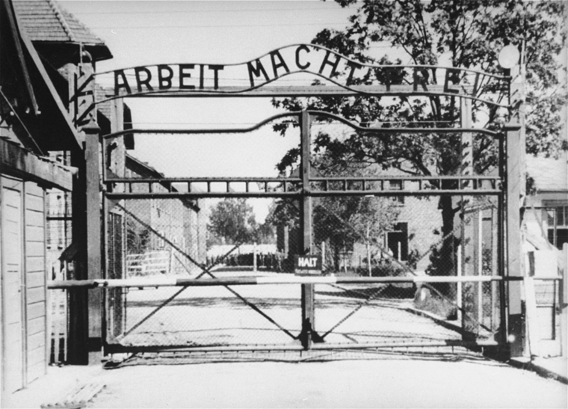

Slide 13
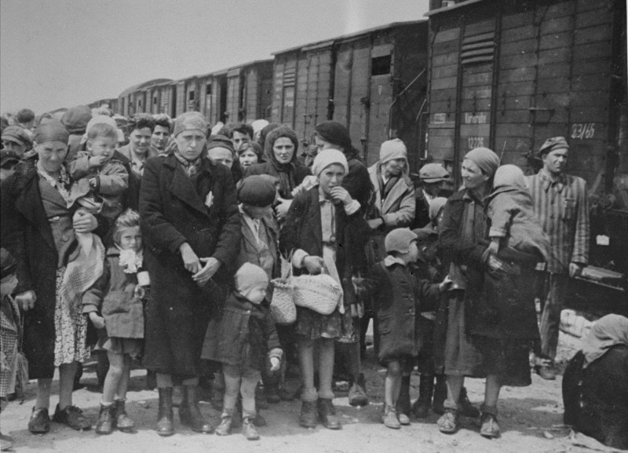

Slide 14
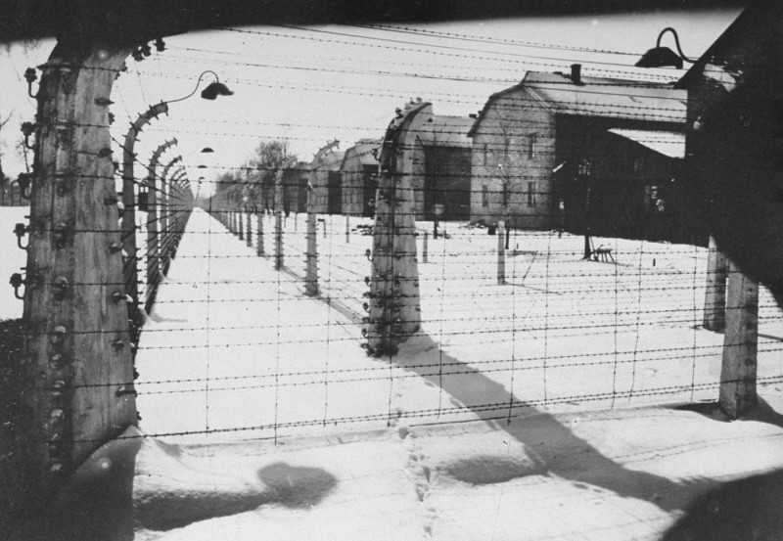

Slide 15
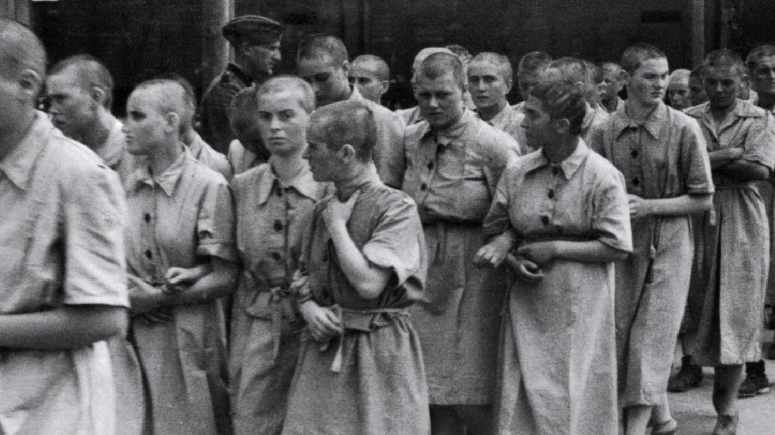
Life inside Auschwitz

Slide 16
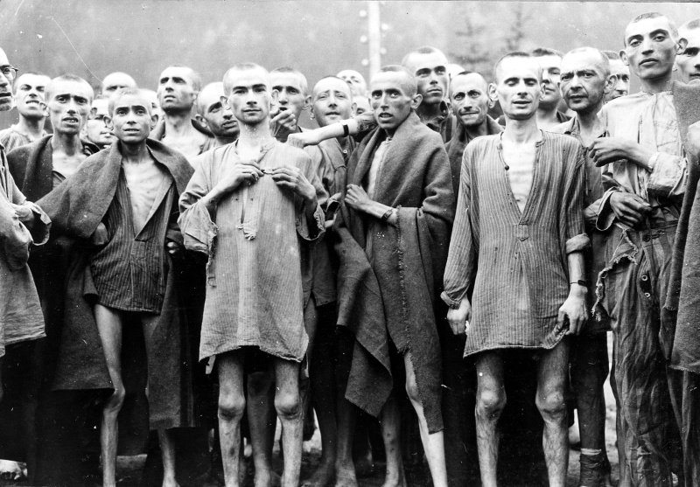

Slide 17
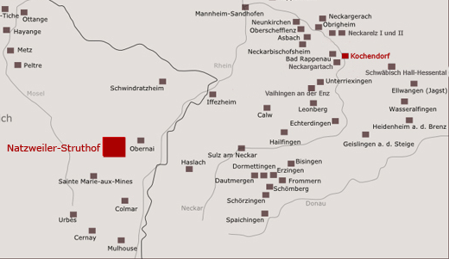
Geislingen Camp, subcamp of Natzweiler-Struthof

Slide 18
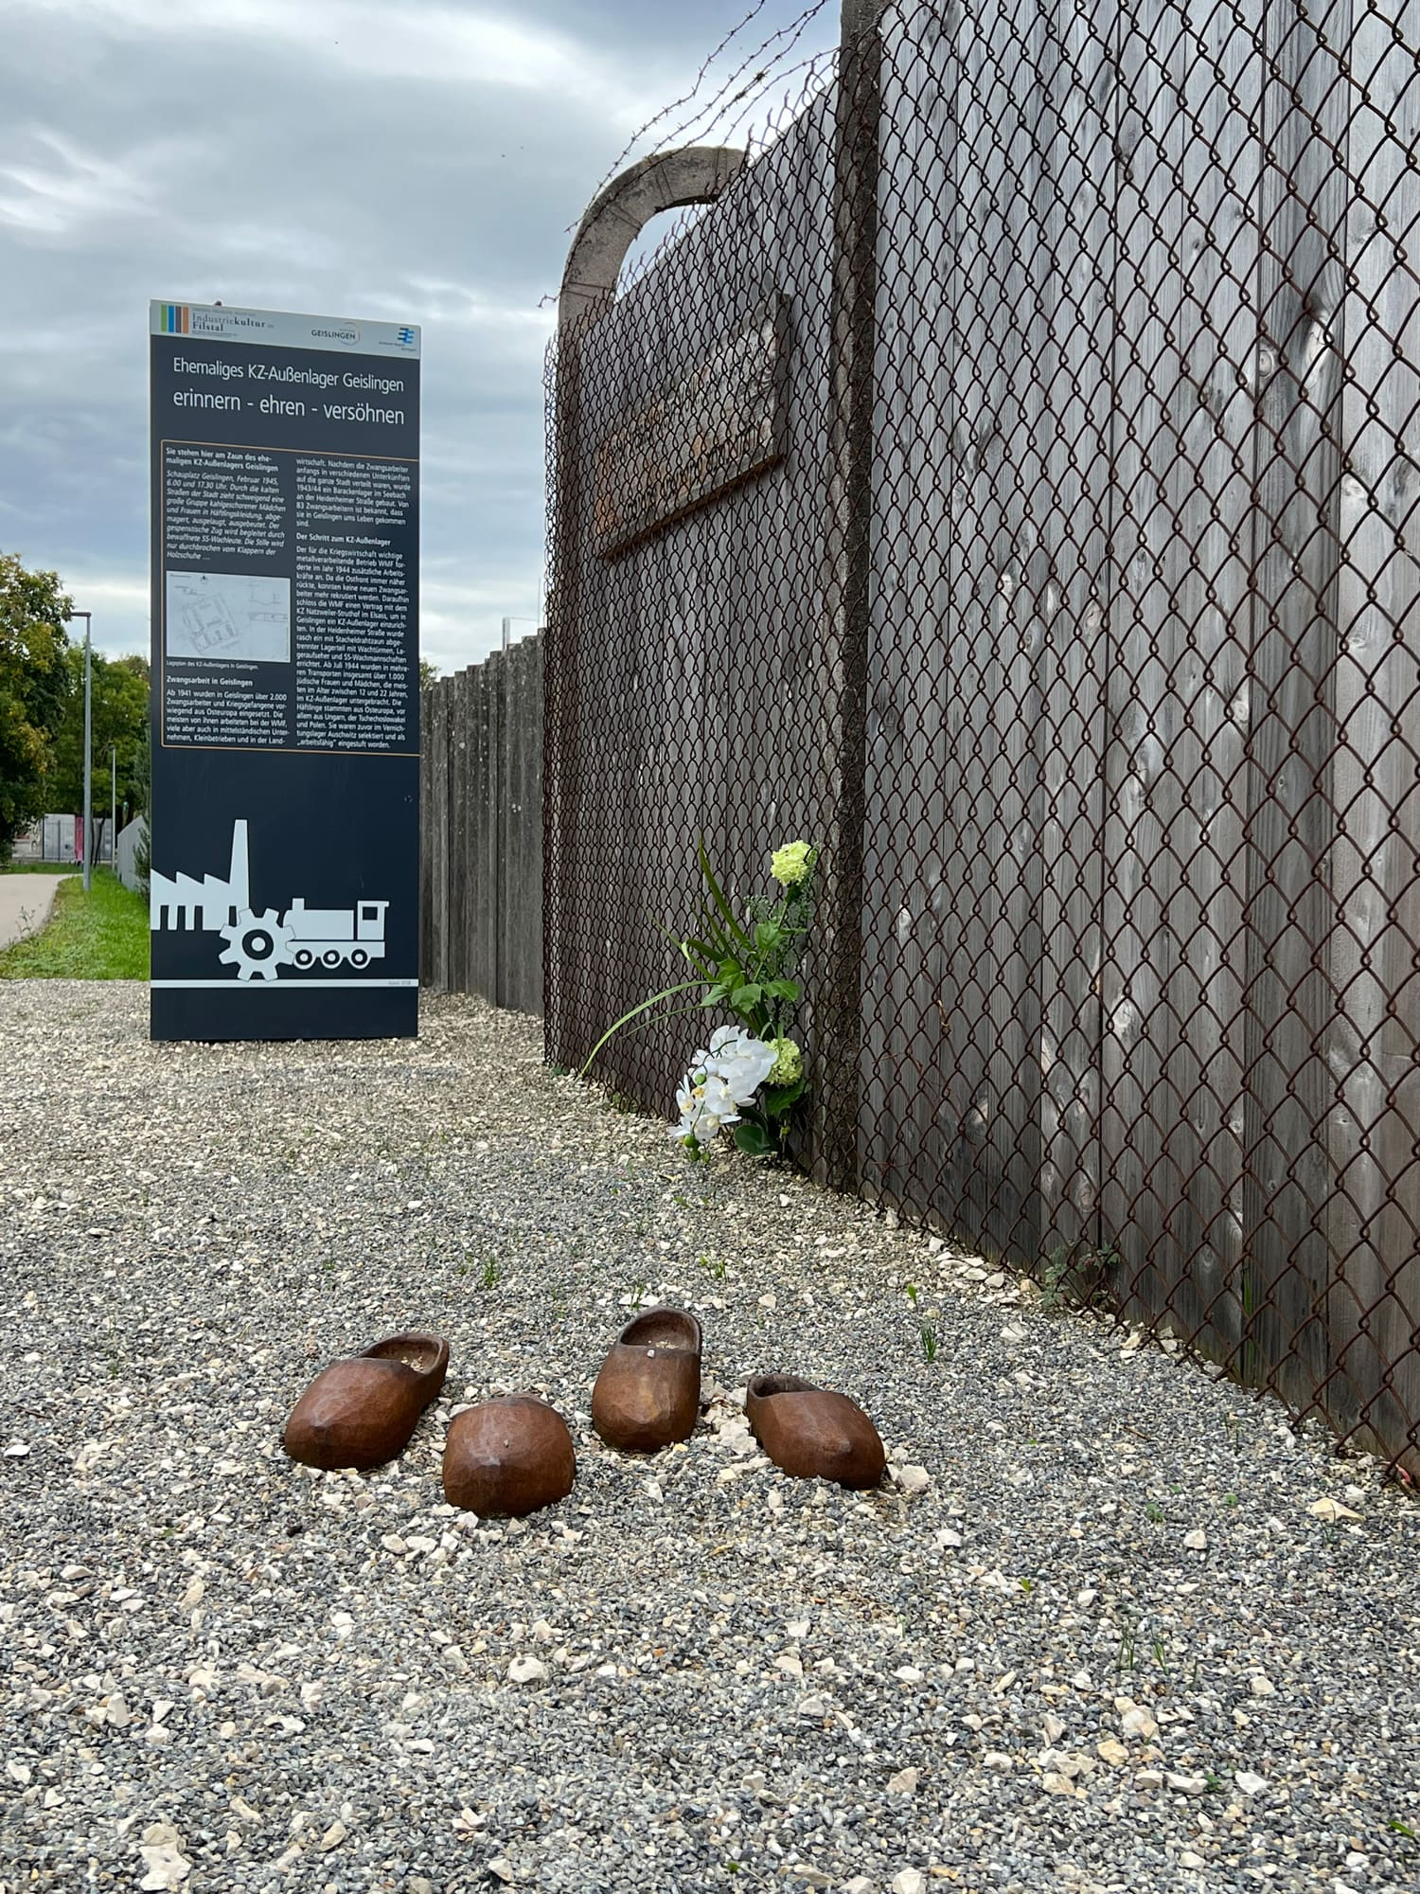
Outside the Geislingen site where the camp was. Credit: https://www.kz-geislingen.de/en/memorials/concentration-satellite-camp/

Slide 19
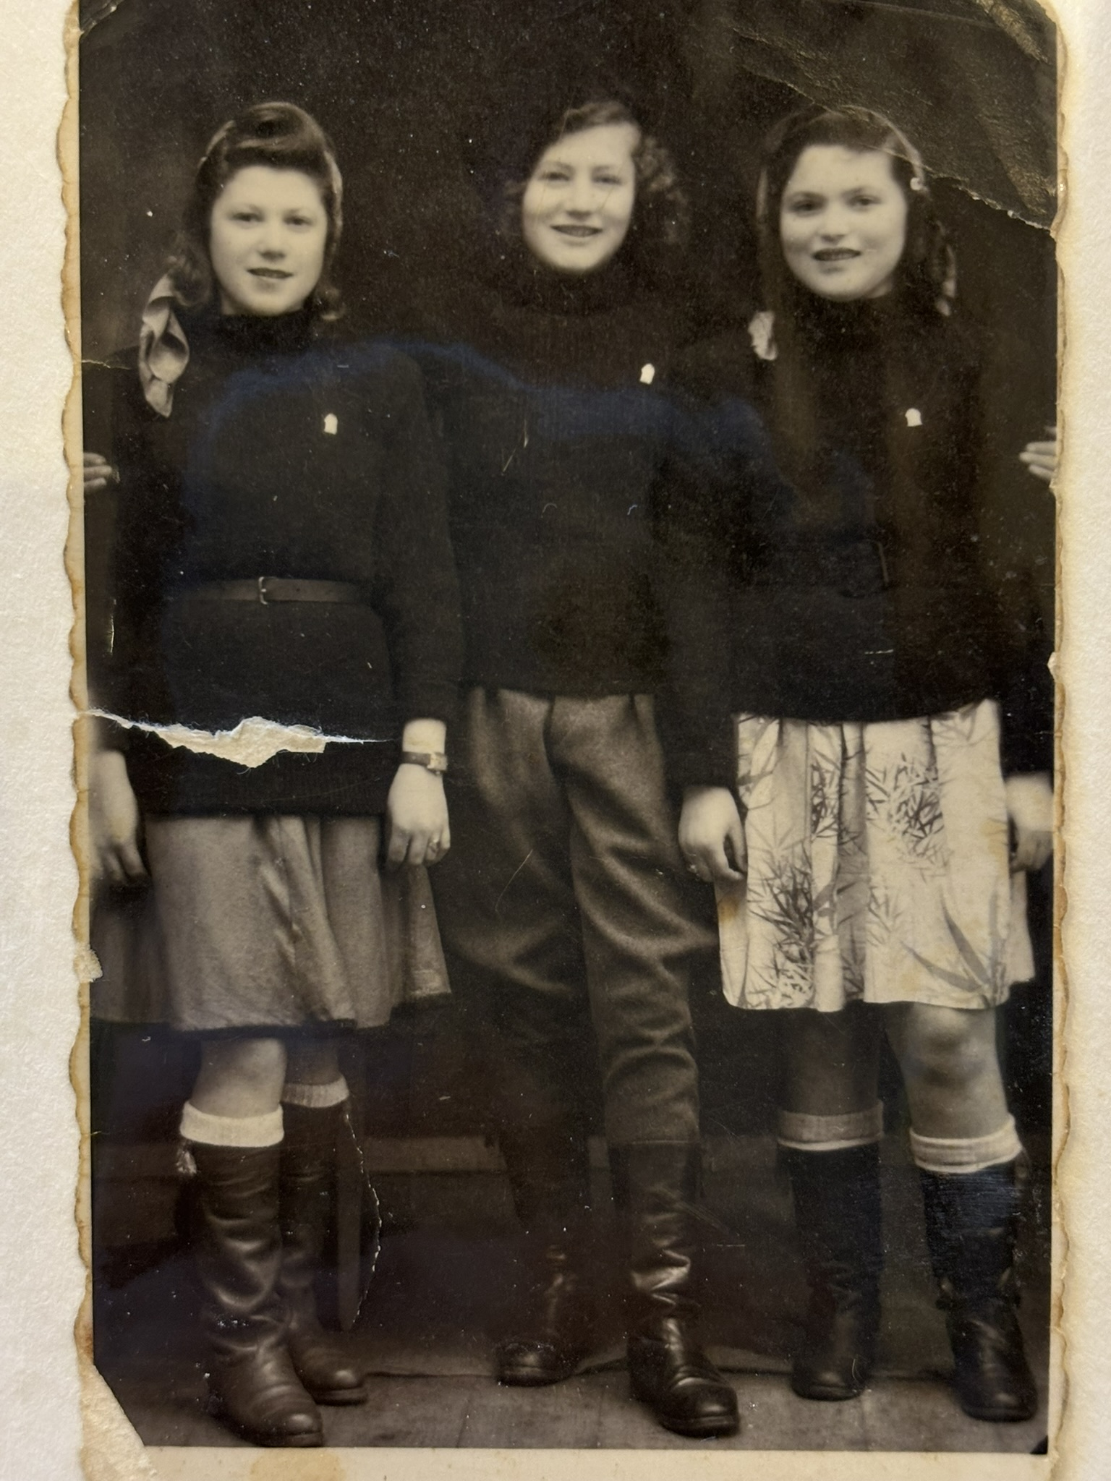
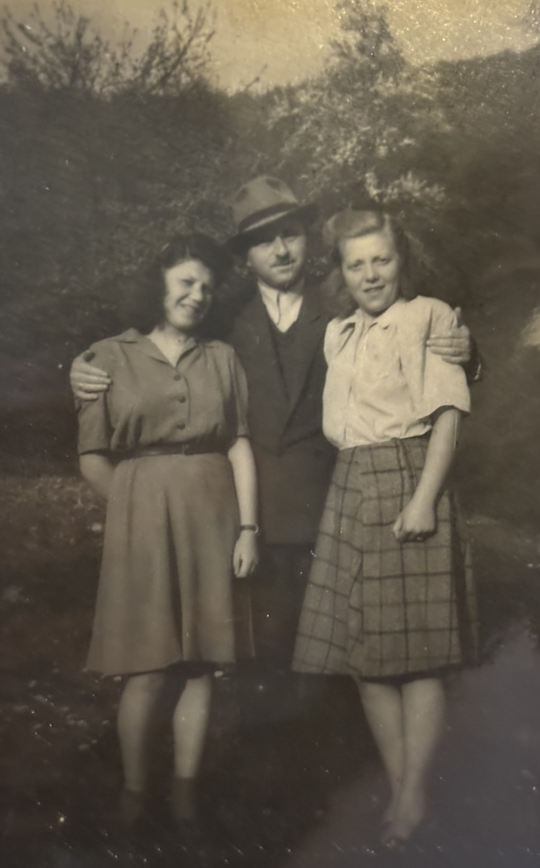
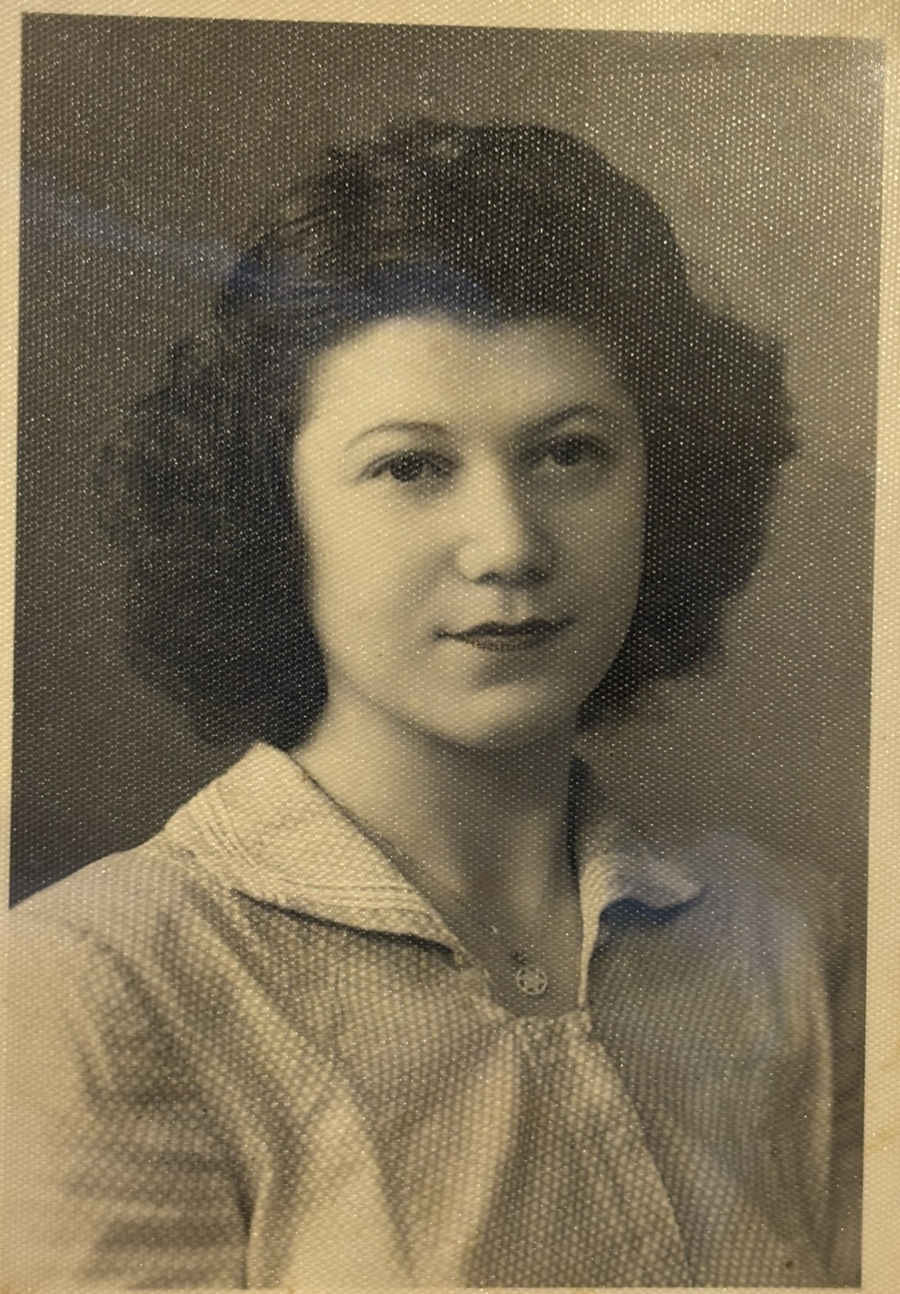
Ruti, after the war
With her sister Ella and Ella’s Husband, Harry Matlai

Slide 20
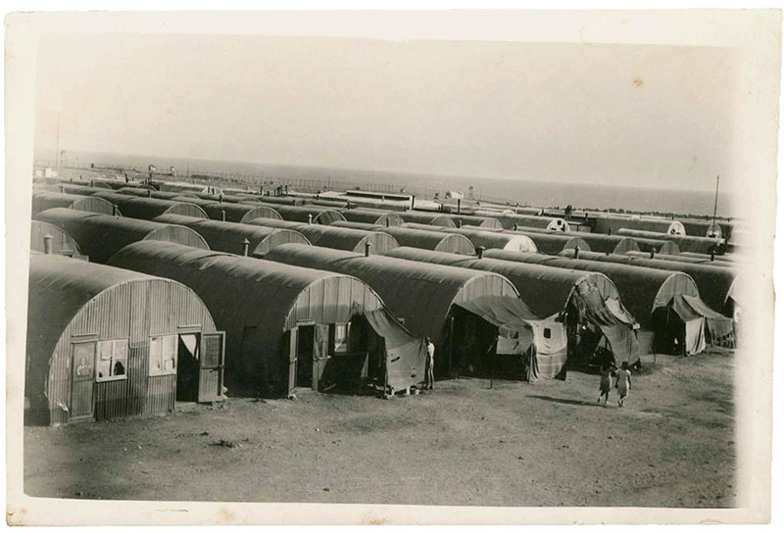
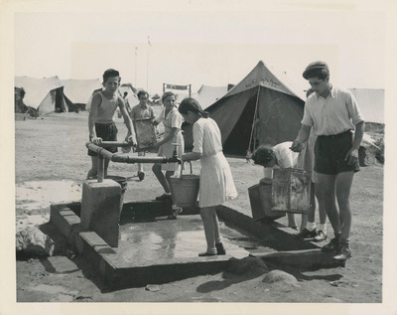
DP camp in Cyprus where Ruti lived for over a year until a boat took her to Israel.

Slide 21
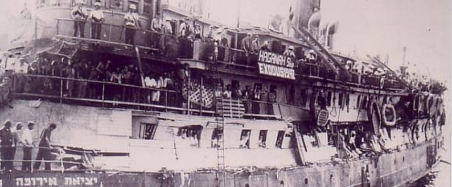
Illegal boats filled with refugees to get to Israel

Slide 22
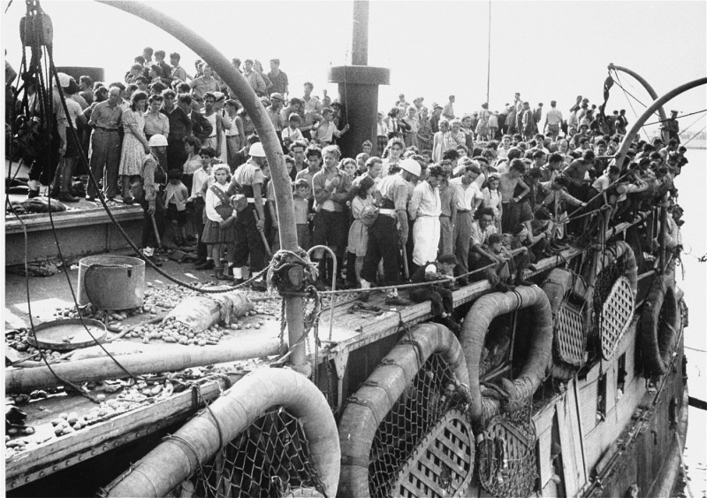
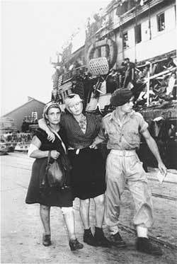
Boats arriving in Israel

Slide 23
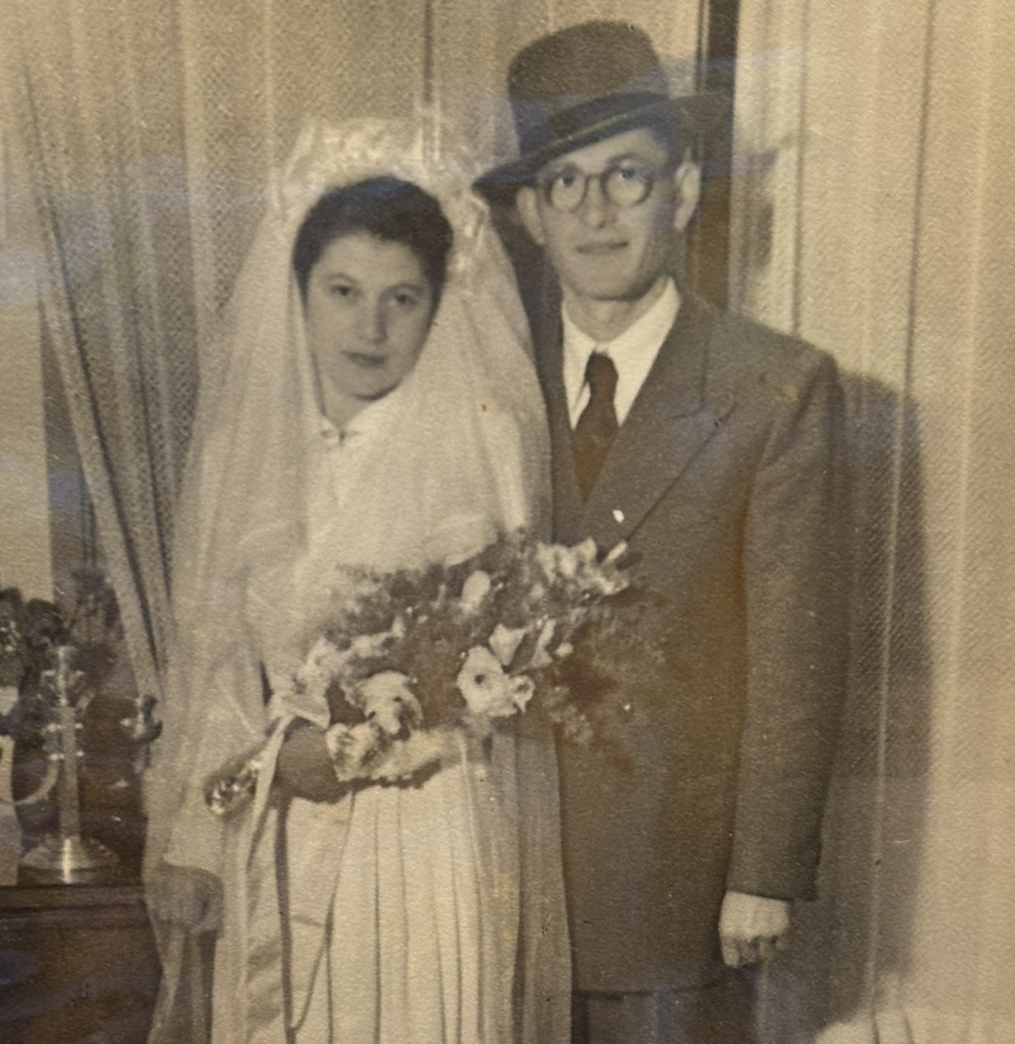
Mordechai and Ruti on their wedding day.
January 1951 in Haifa, a city in northern Israel.
Ruti was 20 years old, and Mordechai was 27.

Slide 24
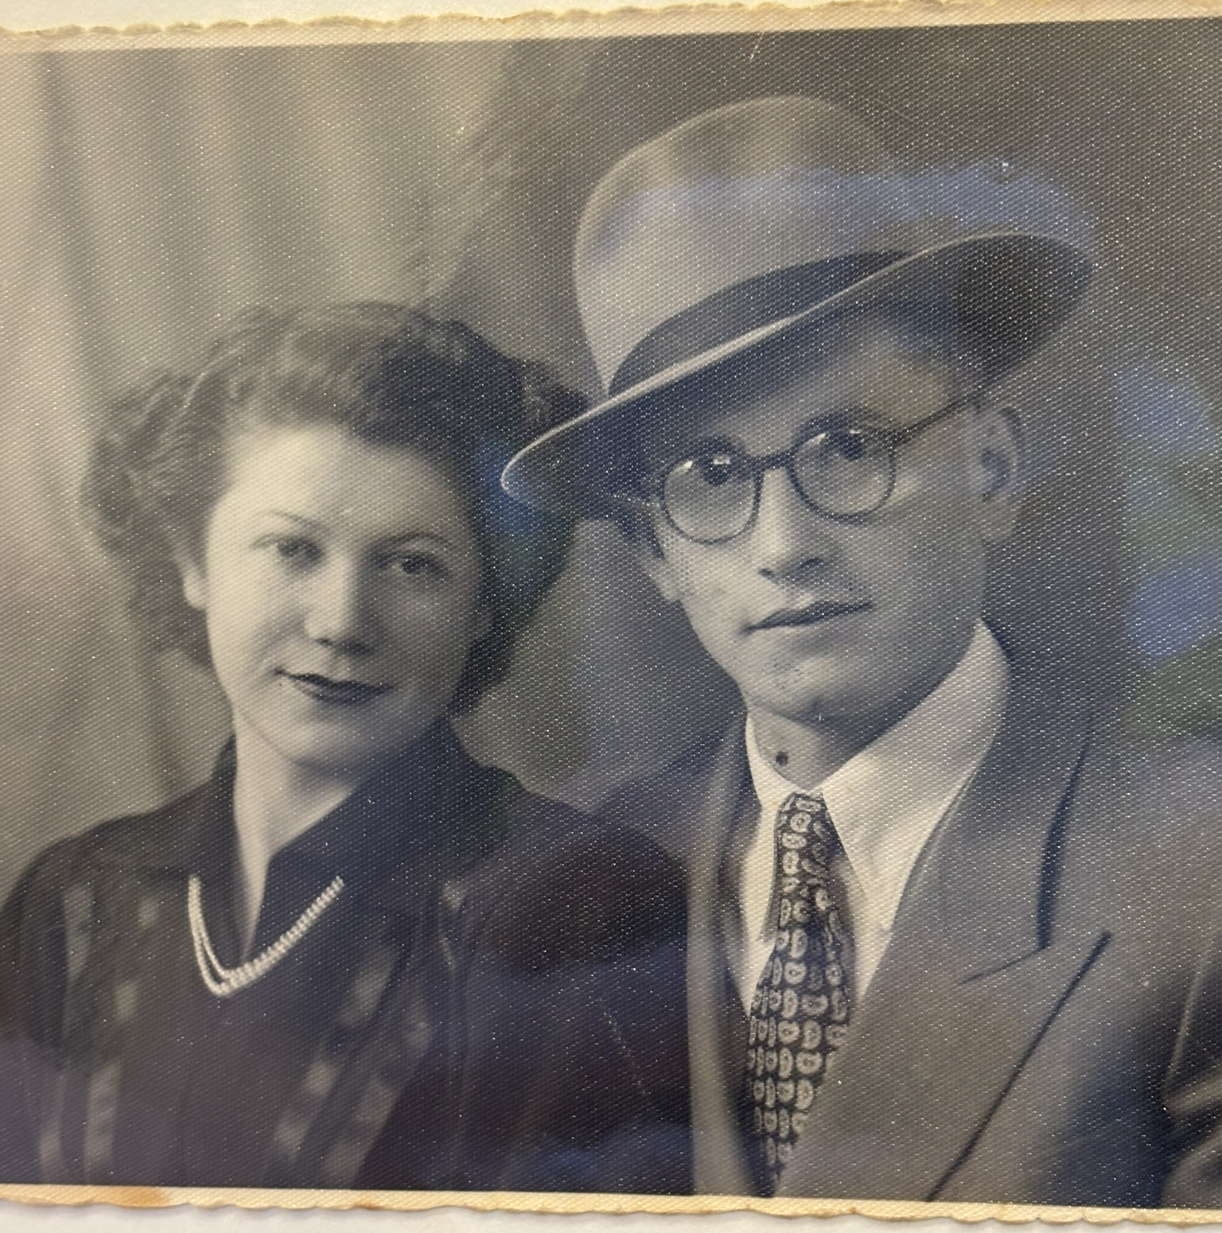
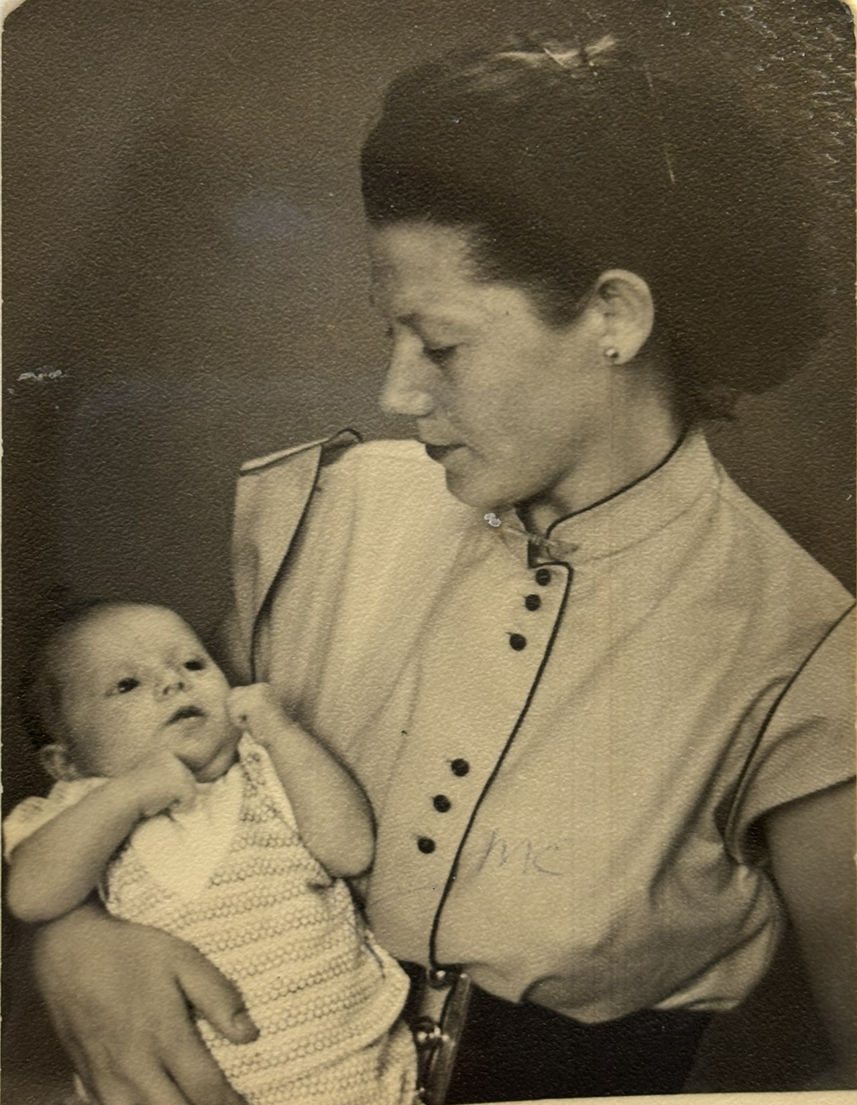
Mordechai and Ruti Gruber in 1952
Ruti and my mother Sara, 1953

Slide 25
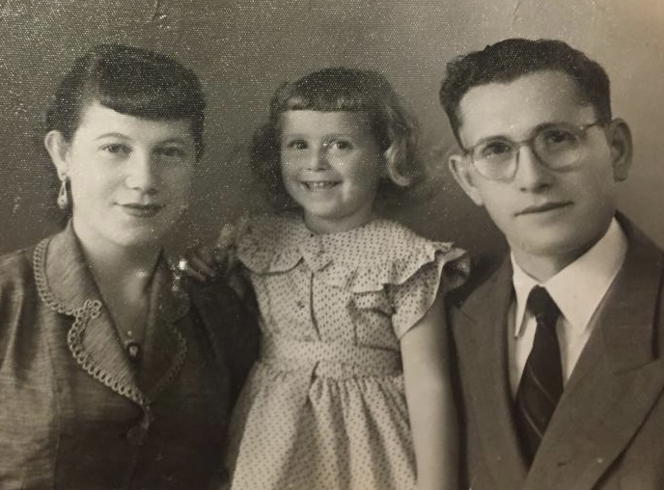
Life in Haifa, Israel
A photo of my mother Sara in the middle taken in Haifa, a city in Israel around 1957

Slide 26
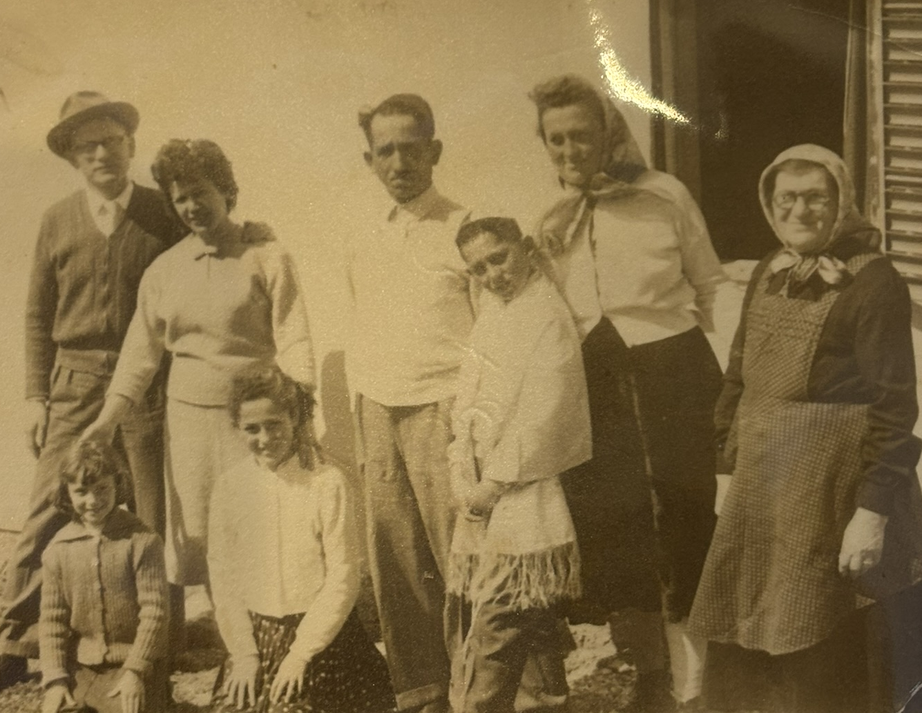
Life living in Israel
Far right is Mordechai’s Mother Etel, who moved to Israel in 1951 with her two surviving daughters – Jenny and Lenke. Here is Jenny with her husband Meshulam and their two children, Moshe and Tziporah on Moshe’s Bar Mitzvah.
Mordechai, Ruti and Sara are on the left of the photo.

Slide 27
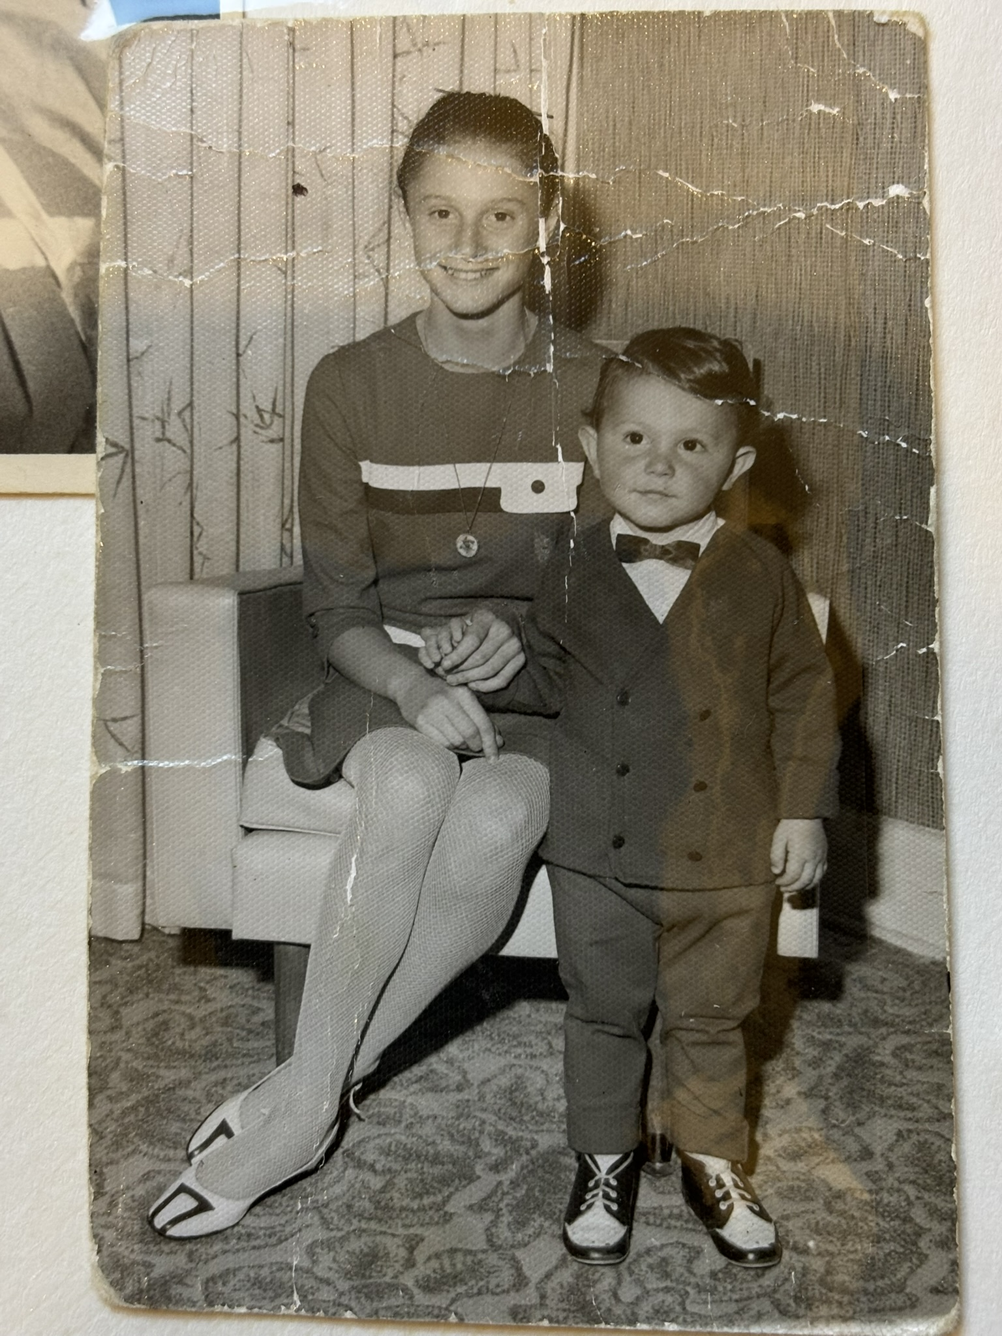
Sara is here with her brother Danny who was born in 1967 in Melbourne, Australia Danny later married his wife Debbie. They have two sons, Michael and Liam.

Slide 28
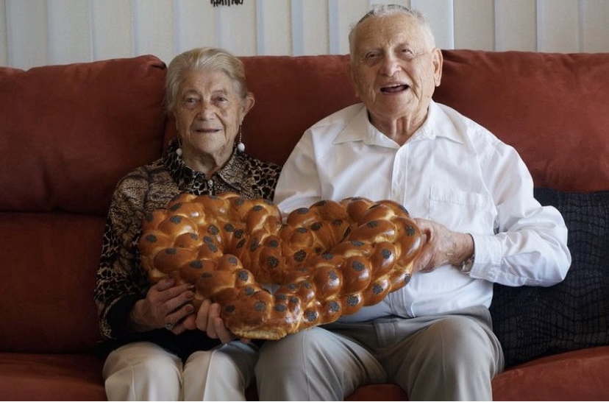
Mordechai was a well known baker in the Jewish community . He baked this Heart Shaped Challah Bread, Jewish Bread in honour of his 90th birthday celebration.

Slide 29
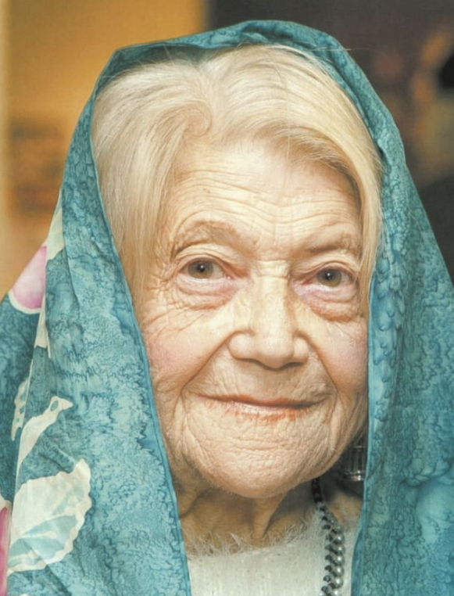

Slide 30
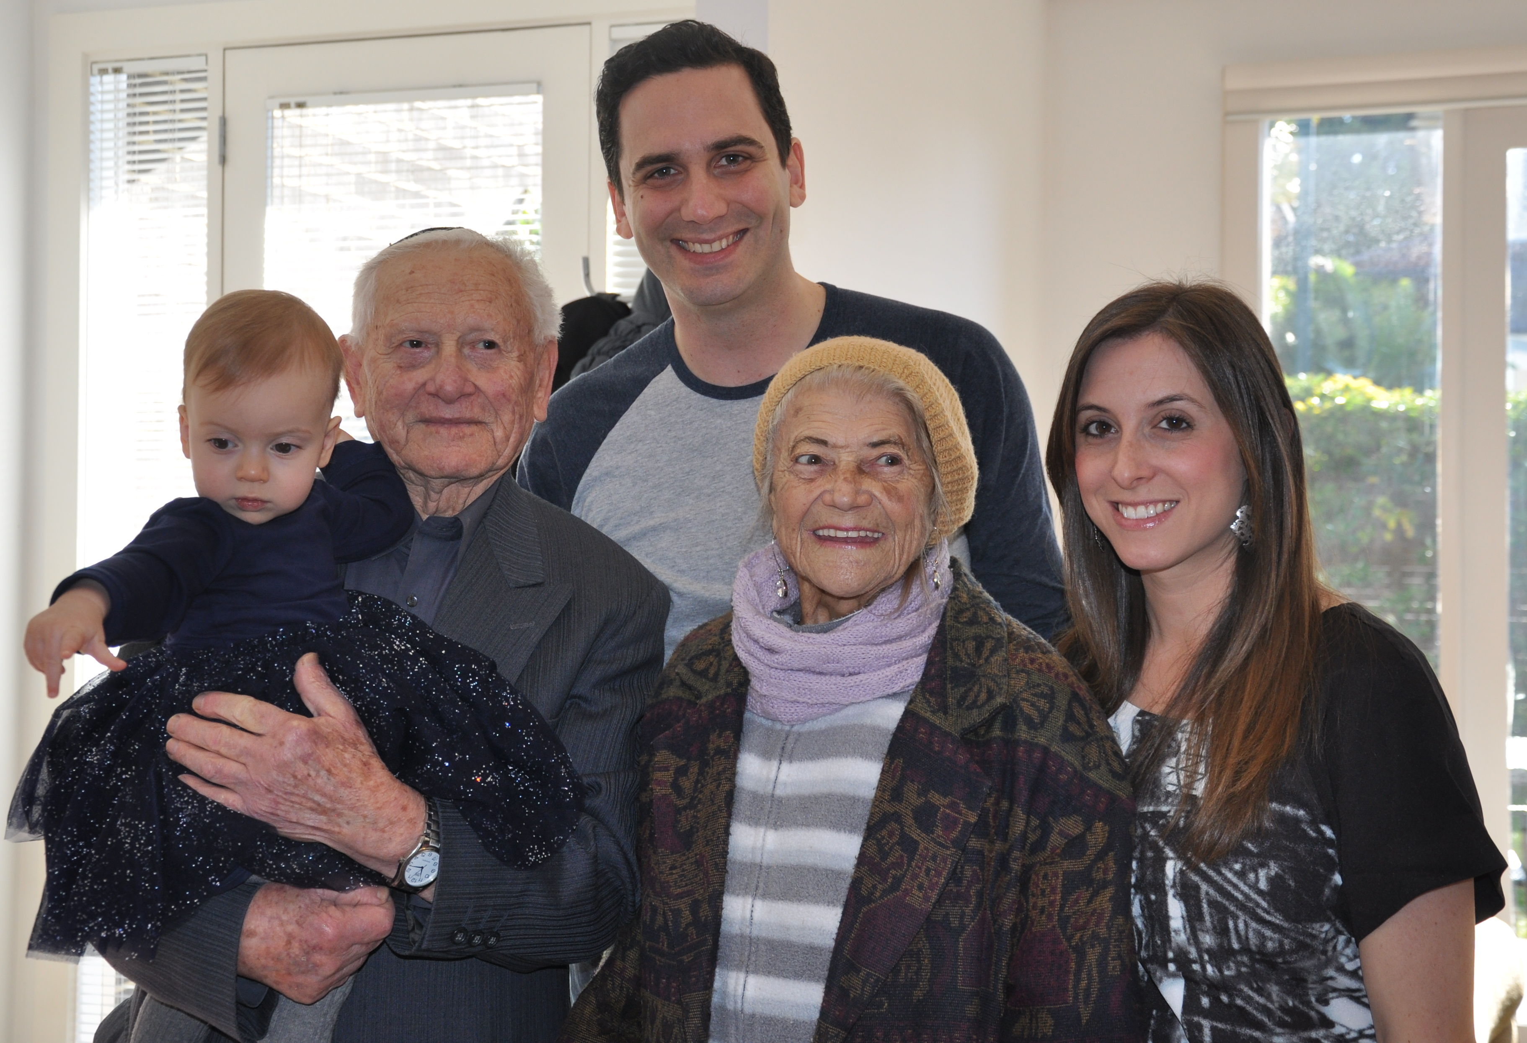
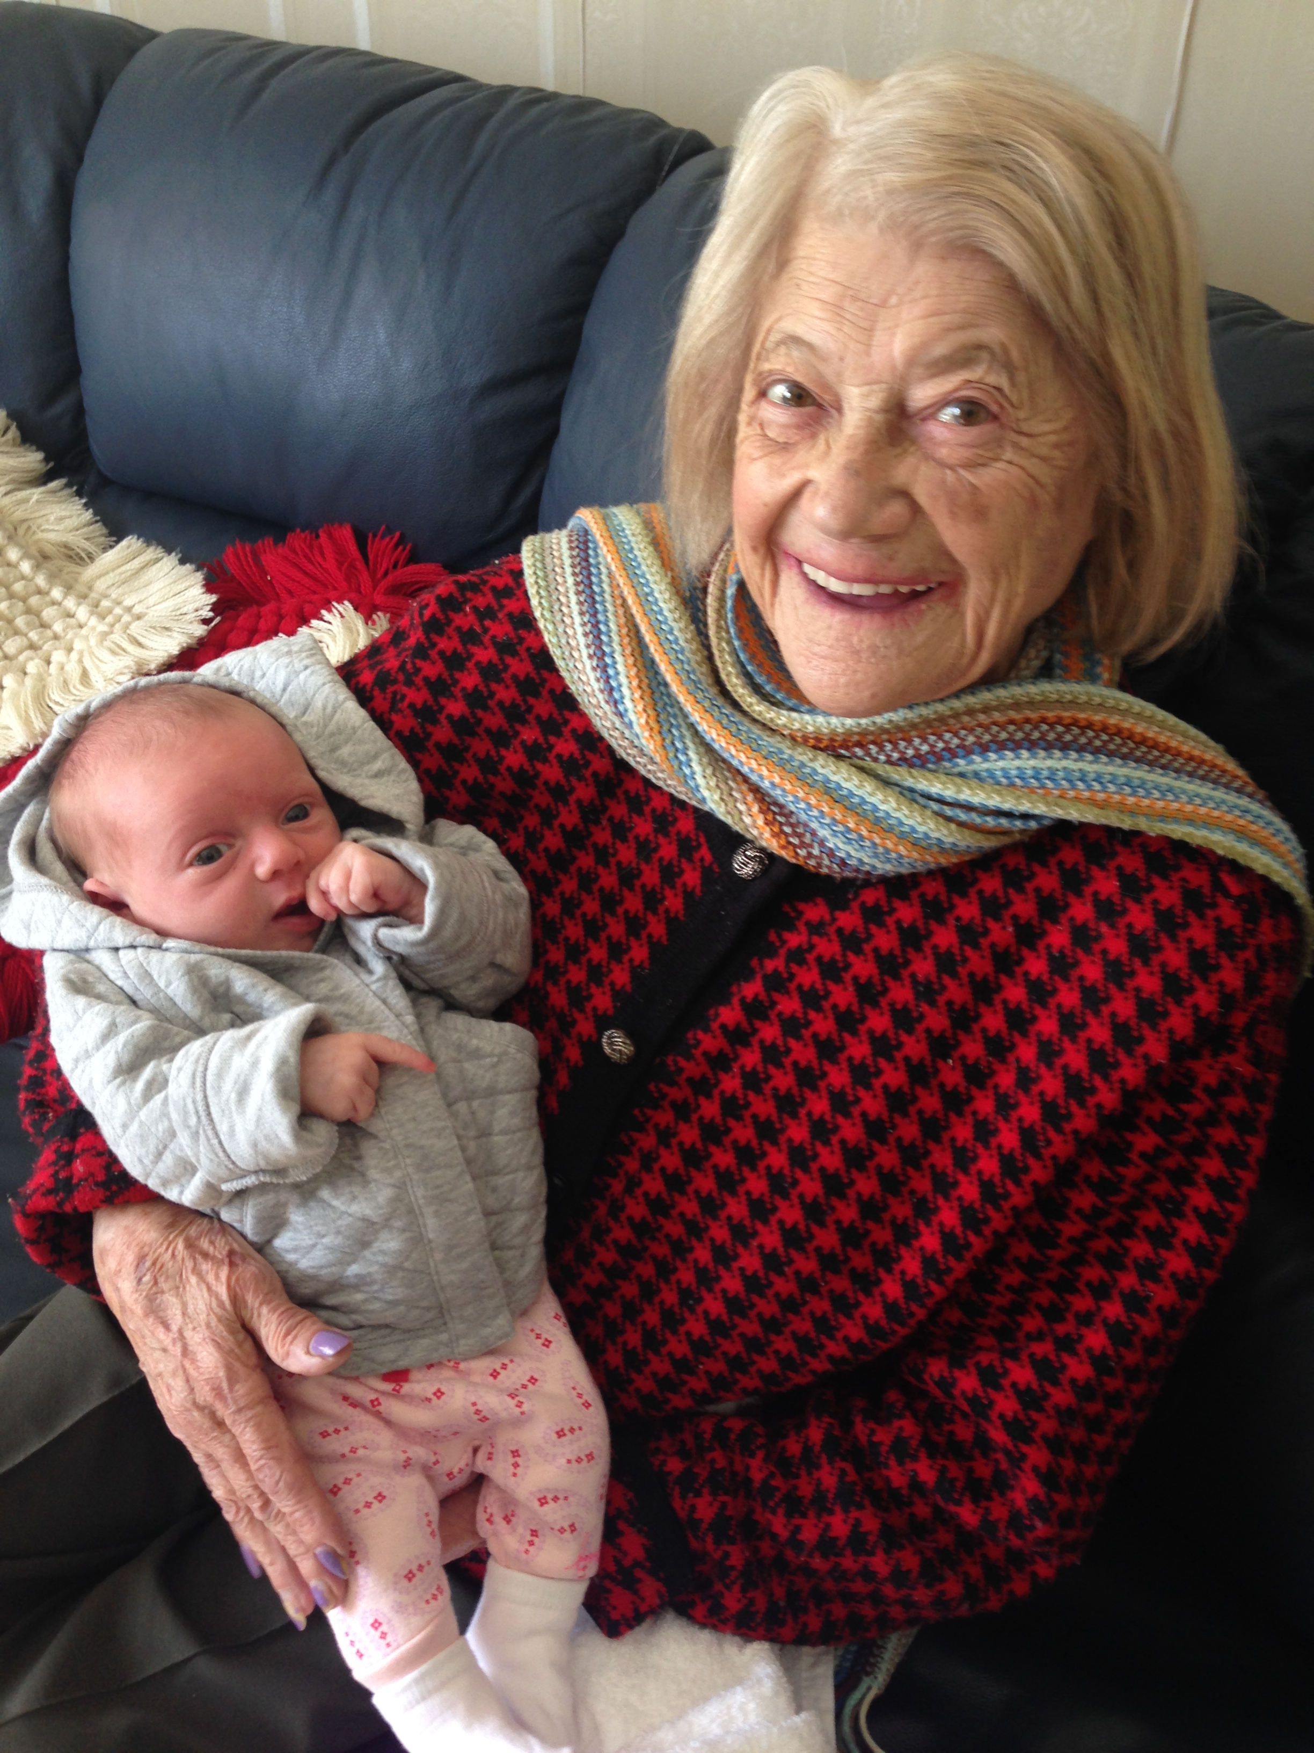
They were both wonderful grandparents who adored their grandchildren and especially great grandchild.
Above: My daughter Millie’s first birthday with my husband Simon

Slide 31
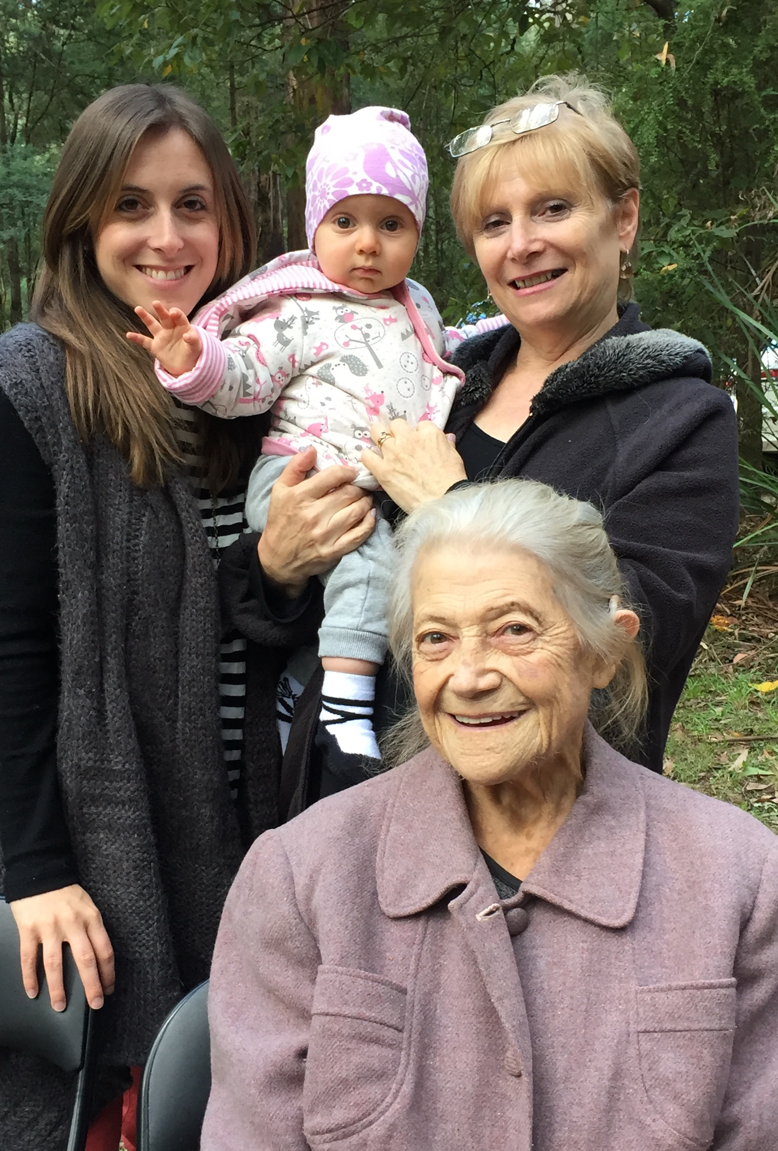
Four Generations of Gruber/ Garfield Women
Ruti, my mother Sara, Esther (me) and my daughter Millie

Slide 32
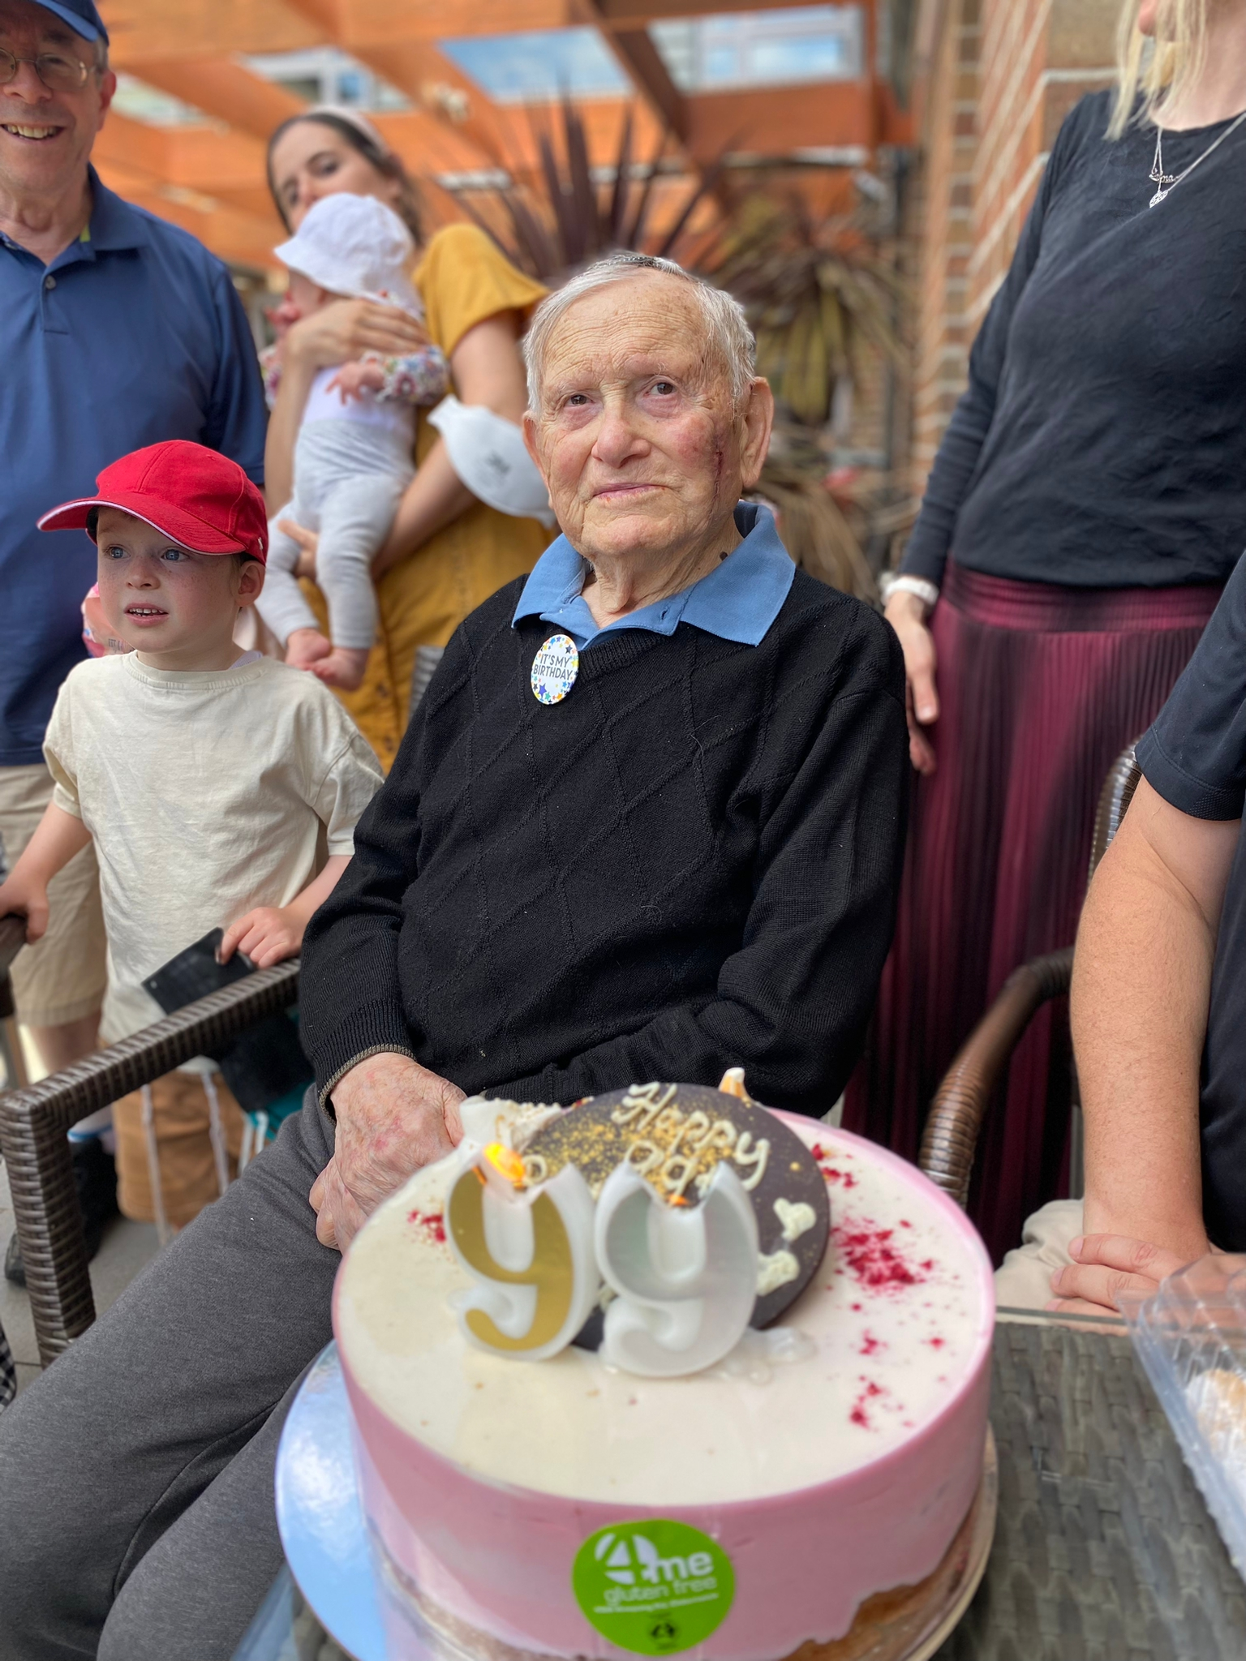
Ruti passed away in Melbourne in 2016, and Mordechai in January 2024.
Here is Mordechai on his 99th birthday. He passed away just 7 days before he turned 100.

Slide 33
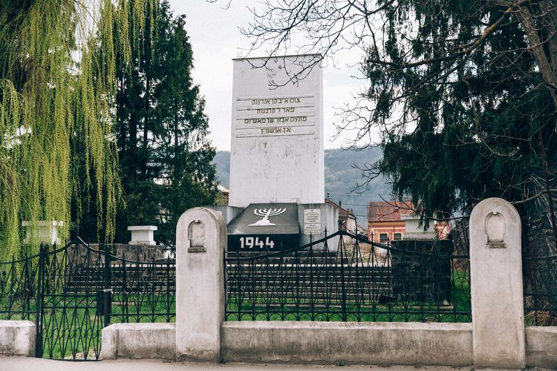
Sighet Memorial Site, honoring the Jewish community that perished at the hands of the Nazis

